Slide 1

“
Big Data Project Book-Crossing Dataset
Vestina Gurevich – 320766744
Iris Markus - 205745128
Orly Tafilay - 206016859

Slide 2

About the Dataset
“
The Bookcrossing (BX) dataset was collected in a 4-week crawl from the Bookcrossing community. It contains 278,858 users (anonymized but with demographic information) providing 1,048,575 ratings (explicit/implicit) about 271,379 books

Slide 3
Project Process Content
Step 1 – Using Spark Program, associated with Google Collaboratory | First, we created a local Spark session, while using Google Collaboratory Program to share our updates with each other. We called the necessary Spark libraries and mounted the data files from our drive.
Step 2 – Cleaning the data with Spark | We took the 3 initial “dirty” files and cleaned the unnecessary and unclear data that existed inside them. We used multiple methods from the ISBN library to create one main cleaning function (ISBN_Treatment). We also created new functions from the pycountry library, such as: findCountry_alpha3() and findCountry_name(). The cleaned files were transfered back to a CSV format.

Slide 4
Project Process Content
Step 3 – Designing a Star Scheme model | From the data we cleaned, we created a star schema model that was built out of the foloowing 3 dataset: Users – Dimension Books – Dimension Book Ratings – Fact
Step 4 – Working with Tableau | We made visualizations that can help us understand the data better.

Slide 5
Project Summary
01
02
03
Data Cleansing
Data Modeling
Data Visualization
Cleaning the data with Spark
Creating a Model of Star Schema from the clean data
Creating Visualizations with the Tableau Program
“

Slide 6

01
Users Data
The Analysis and Conclusions on the Users data
“

Slide 7
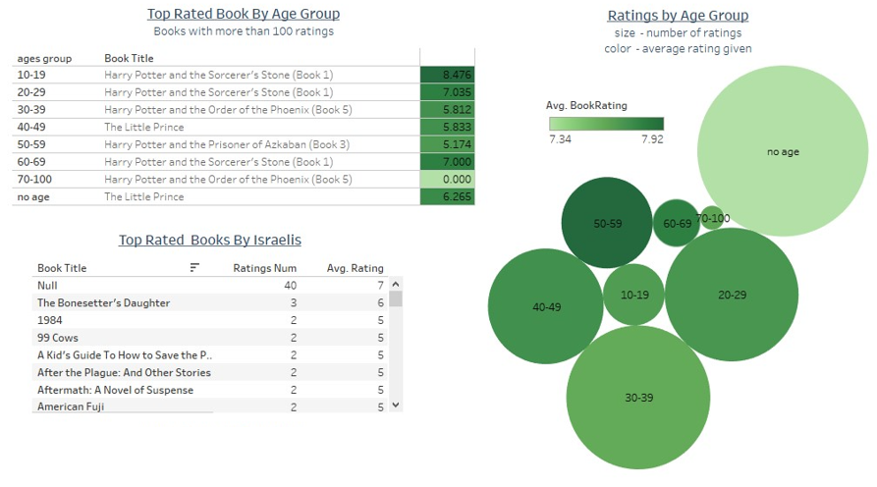
Users Data:
We can see that most of the ratings come from a group that didn’t fill its’ age (no age group). The second top raters are from age group 30-39.
We can see that the highest score ratings come from age group 50-59.
We can see that the most popular book by age group 10-19 was: Harry Potter and the Sorcerer’s Stone (Book 1), with the score of: 8.47
We can see that the least popular book by age group 70-100 was: Harry Potter and the Order of the Phoenix (Book 5), with the score of: 0
“

Slide 8
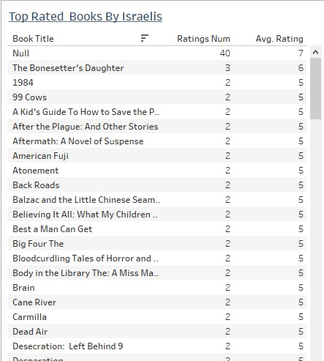
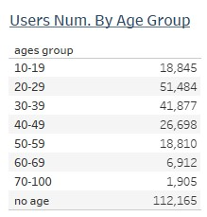
Users Data:
We can see that most of the users are from age group “no age” (112,165 users), while the minority of the users come from age group 70-100 (1,905 users).
We can see that the top identified rated book by Israelis is The Bonesetter’s Daughter, with average rating score of 6 and 3 rating users.
“

Slide 9
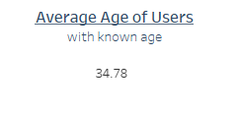
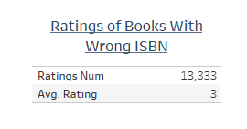
Users Data:
We can see that the average age of the users (with a known age) is 34.78
We can see that there are 13,333 users that rated books with a wrong ISBN, and the average ratings of the wrong ISBN stands on a score of 3.
“

Slide 10

02
Books Data
The Analysis and Conclusions on the Books data

Slide 11
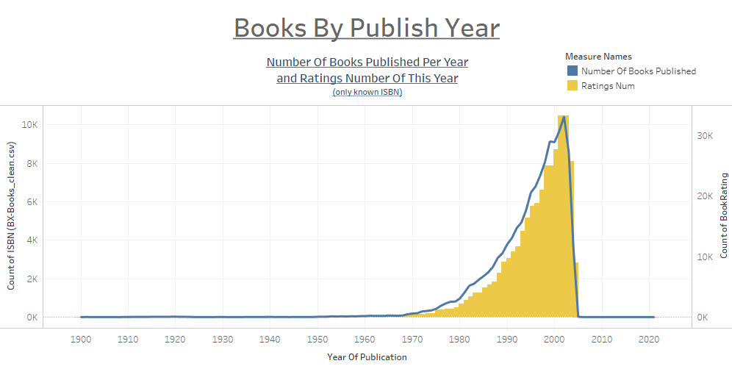
Books Data:
We can see that the highest number of books published was by the year 2002, with the amount of 10,421 publications. We can also see that the highest rating amount is also in 2002, with 33,341 ratings.
We can identify a positive correlation between the number of published books and the ratings amount.
“

Slide 12
Books Data:
We can see the beginning of increased tendency in the number of books published in the year 1970, with 184 books published and 380 ratings.
We can see a sudden decrease in the number of books published between the years 2002-2005, leading to amounts of 12 books published and 39 ratings in 2005.
“

Slide 13
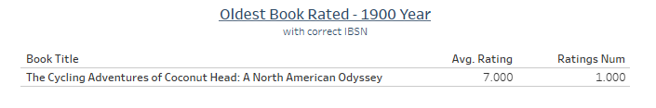
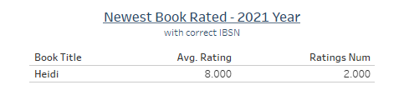
Books Data:
We can see that the oldest book rated was The Cycling Adventures of Coconut Head: A North American Odyssey, and it was written by the year 1900. This book got an average rating score of 7 by 1 user.
We can see that the newest book rated was Heidi and it was written by the year 2021. This book got an average rating score of 8 by 2 users.
“

Slide 14

03
Book Ratings Data
“
The Analysis and Conclusions on the Book Ratings data

Slide 15
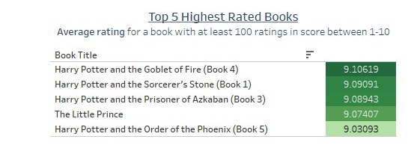
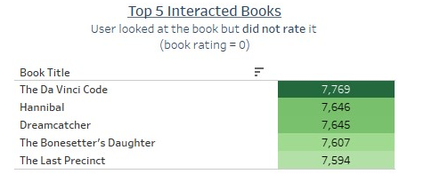
Books Data:
We can see that the Highest Rated book is the book Harry Potter and the Goblet of Fire (Book 4), with a rating of 9.1
We can see that the Highest interacted book is The Da Vinci Code, with 7,769 users that looked at the book but did not rate it.
“

Slide 16
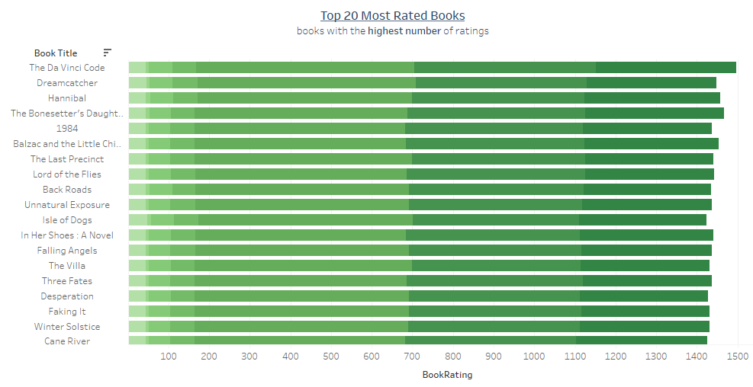
Books Data:
We can see that the Book with the Highest Rating amount is The Da Vinci Code, with 1,489 users that rated the book with a score of 8.
“

Slide 17
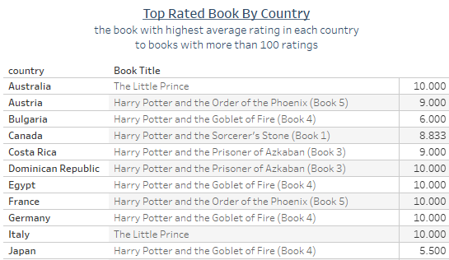
Book Ratings Data:
We can see that the top-rated book by Australia is The Little Prince, with an average rating score of 10
We can see that the top-rated book by Japan is Harry Potter and the Goblet of Fire (Book 4), with an average rating score of 5.5
“

Slide 18
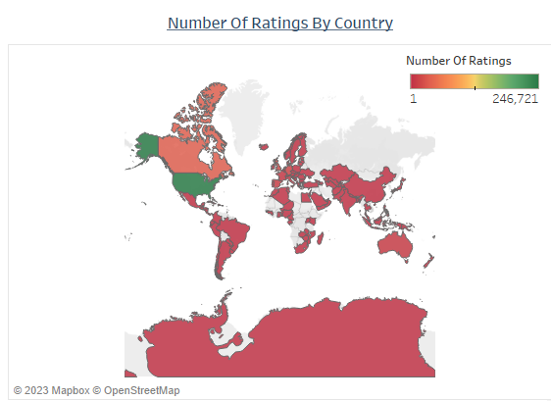
Book Ratings Data:
We can see that the Highest Rating amount comes from the United States with rating amount of 246,721 users, while the lowest rating amount comes from places like South Asia, Australia and most of Europe.
“

Slide 19
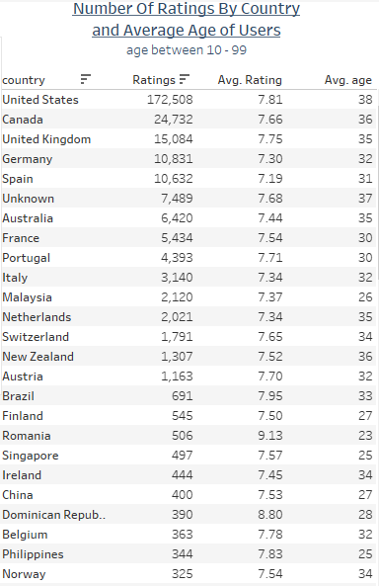
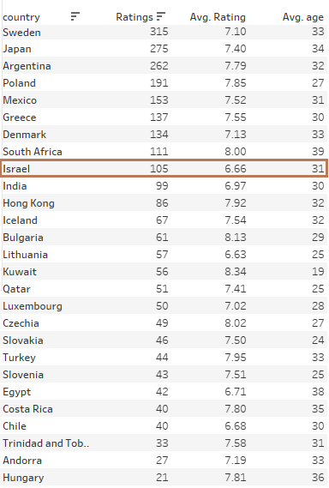
Book Ratings Data:
We can see that the United States has the biggest number of ratings – 172,508 ratings. The average rating score stands with 7.81, and the avg user age is 38.
We can see that Israel has the number of ratings of 105 ratings. The average rating score stands with 6.66, and the avg user age is 31.
“

Slide 20
Conclusions
01
Top Country by Book Ratings
Was the United States, with the higest rating amount (172,508)
02
Best Feedback Reviewrs Age Group
Was the age group of 10-19, that gave an average review score of 8.47
03
Best Rated Book
Was Harry Potter and the Goblet of Fire (Book 4), with a rating of 9.1

Slide 21
Conclusions
04
Best Rating Potential
Belongs to the book The Da Vinci Code, with 7,769 users that looked at the book, but did not rate it.
05
Oldest Book Review
Belongs to a book written in 1990, and got the average rating score of 7
06
Newest Book Review
Belongs to a book written in 2021, and got the average rating score of 8

Slide 22
Popular book publishers in 2xxx
“
 | Neptune | Mercury
Genre | Fiction | Romance
Editorial | Mercury | Pluto
Month of publication | January | February
Awards | Award 1 | Award 2
Author | Susan Bones | Frank Jimmy
ISBN | x-xxxx-xxxx-x | x-xxxx-xxxx-x

